Slide 1




Near-Real-Time Object Recognition using Azure AI and Microsoft Fabric
Sai Prudhvi Neelakantam

Slide 2
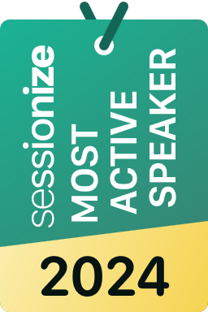






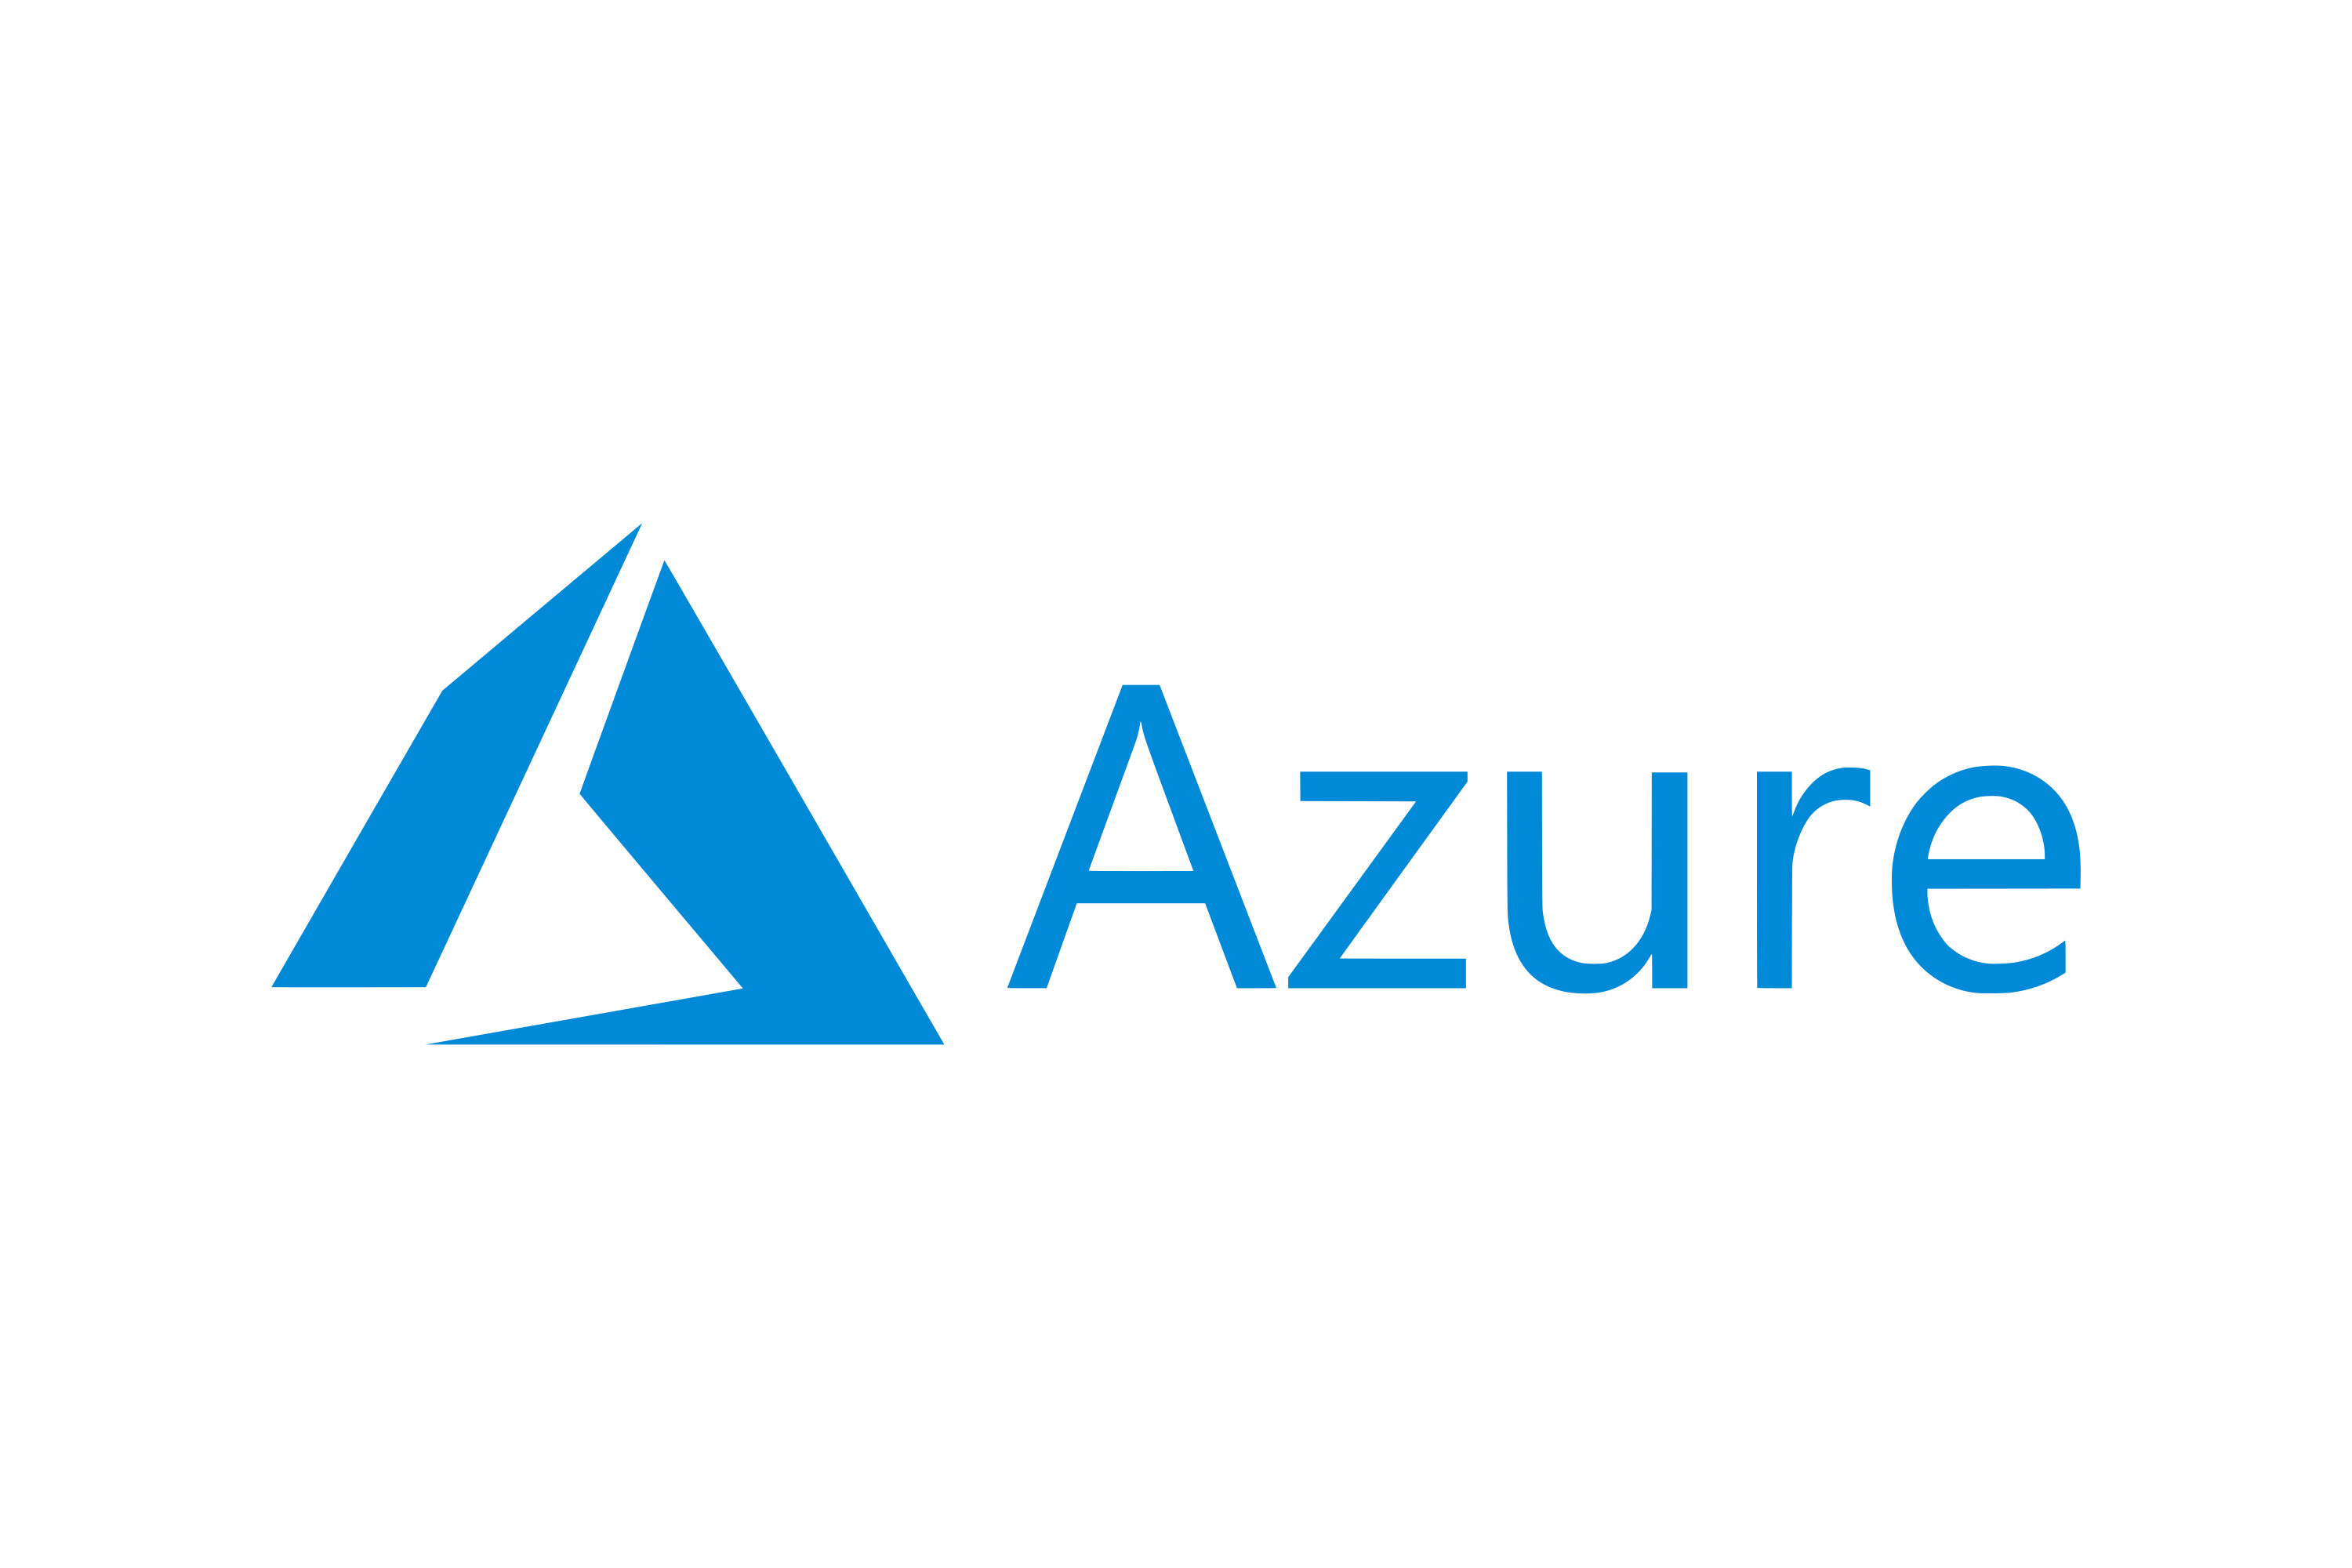








Sai Prudhvi Neelakantam
Data Engineer by❤️
Consultant @
Building ETL pipelines, crunching data & driving insights
Masters in Business Analytics
4+ Certified by Microsoft & Databricks
Geek in Data & AI
in/saiprudhvineelakantam
geekindata.com
Oslo
Norway
sai@geekindata.com

Slide 3
THANK
YOU
FOR CHOOSING TO BE HERE!

Slide 4
Near-Real-Time Object Recognition using Azure AI and Microsoft Fabric
Sai Prudhvi Neelakantam

Slide 5

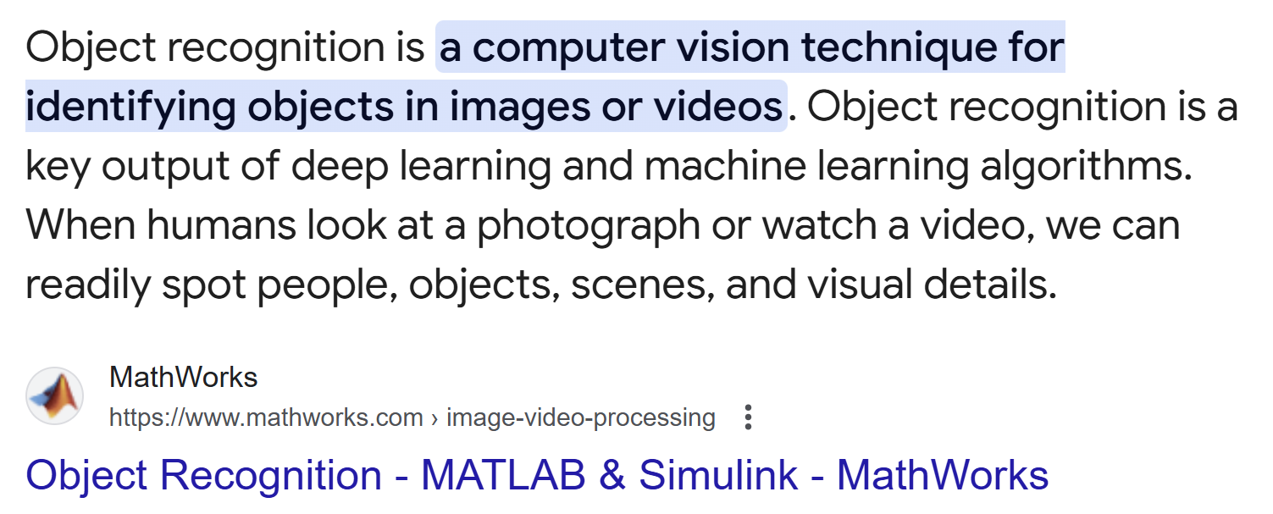
Near-Real-Time Object Recognition using Azure AI and Microsoft Fabric | Sai Prudhvi Neelakantam
Power BI & Fabric Summit 2025

Slide 6

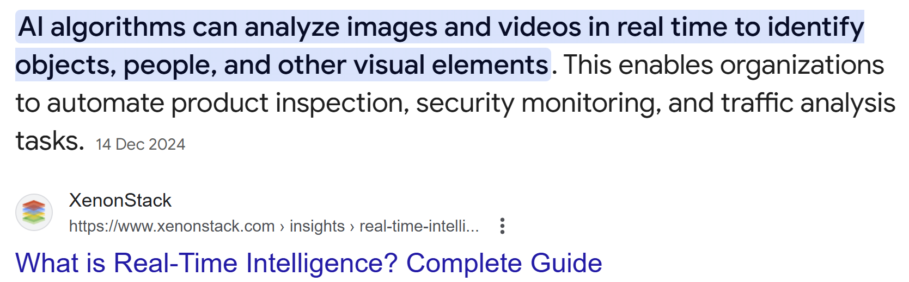
Near-Real-Time Object Recognition using Azure AI and Microsoft Fabric | Sai Prudhvi Neelakantam
Power BI & Fabric Summit 2025

Slide 7
Real-Time Object Recognition Use Cases?
Near-Real-Time Object Recognition using Azure AI and Microsoft Fabric | Sai Prudhvi Neelakantam
Power BI & Fabric Summit 2025

Slide 8
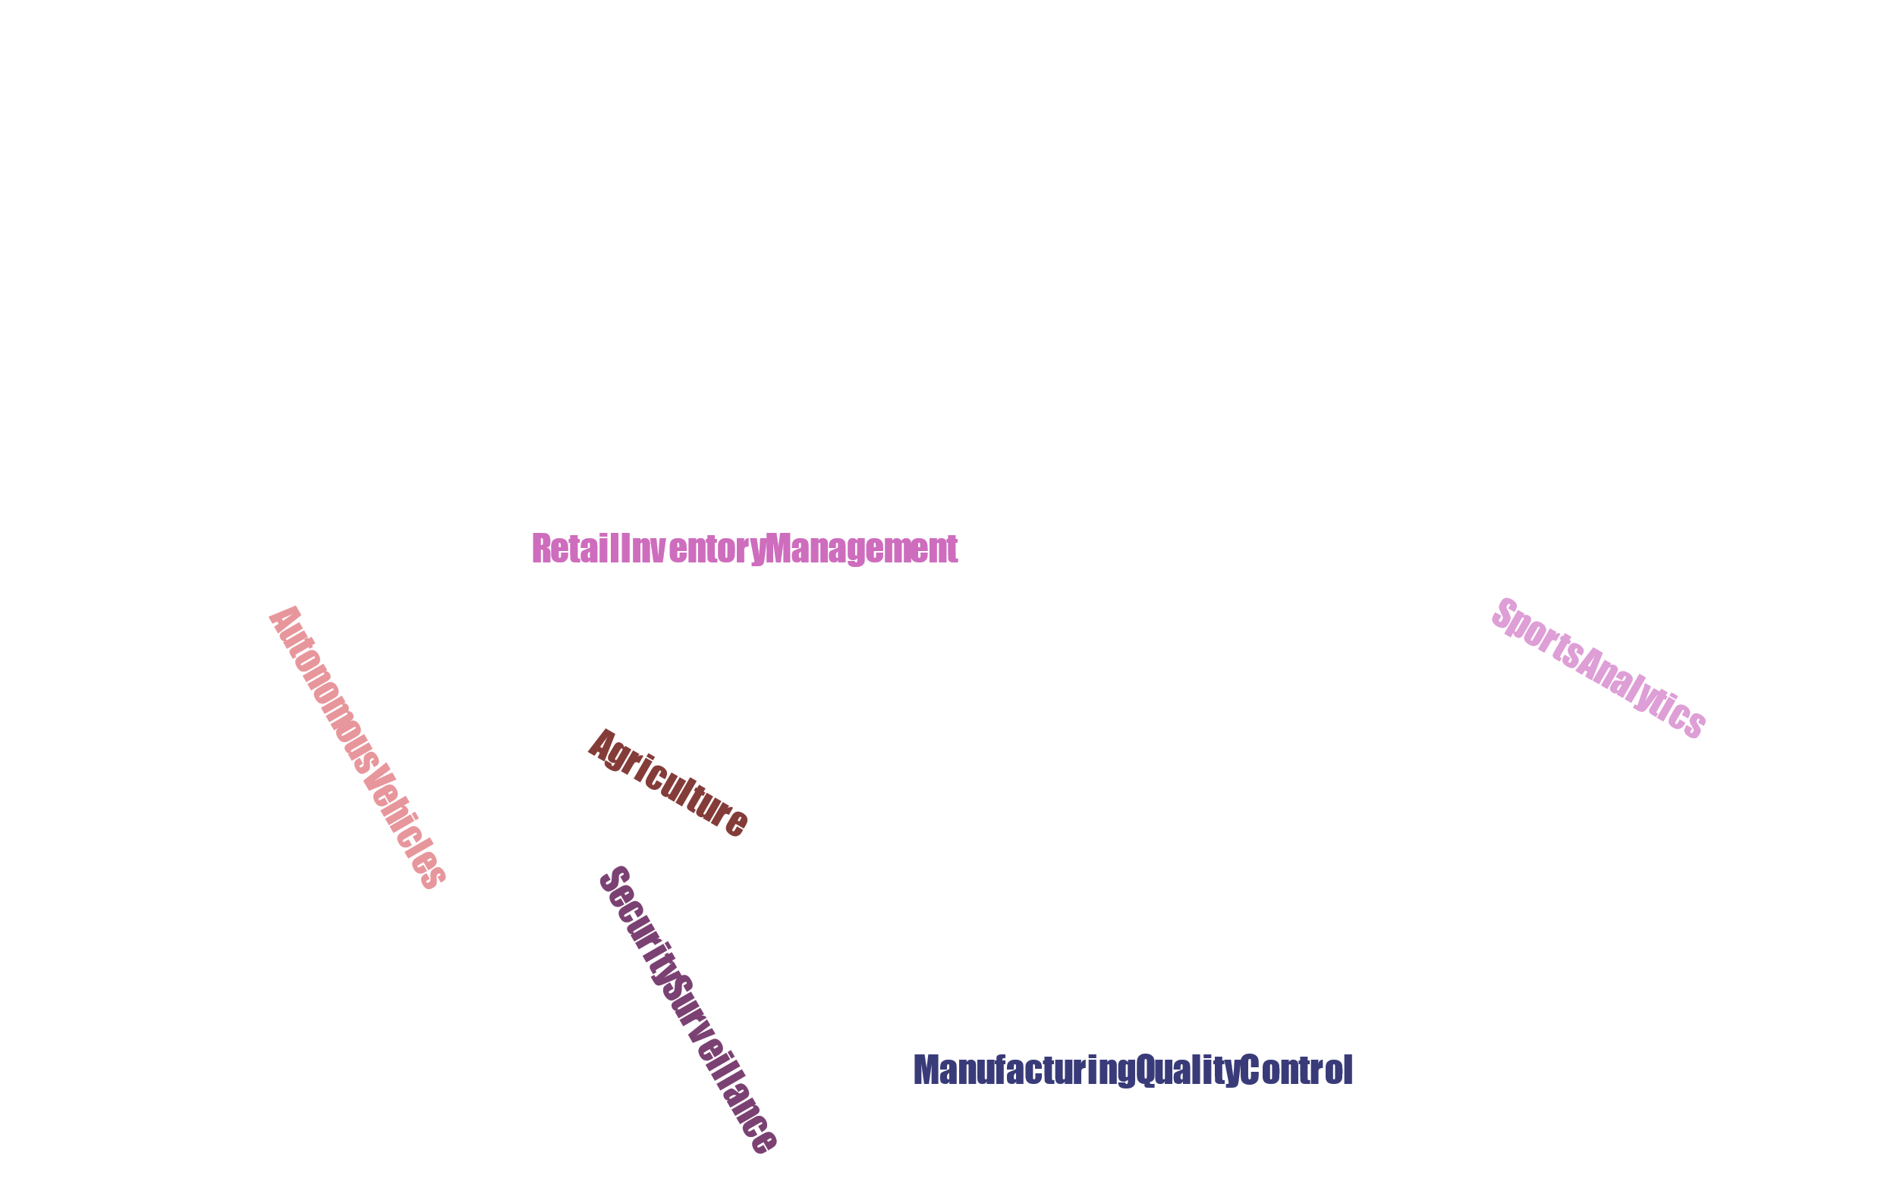
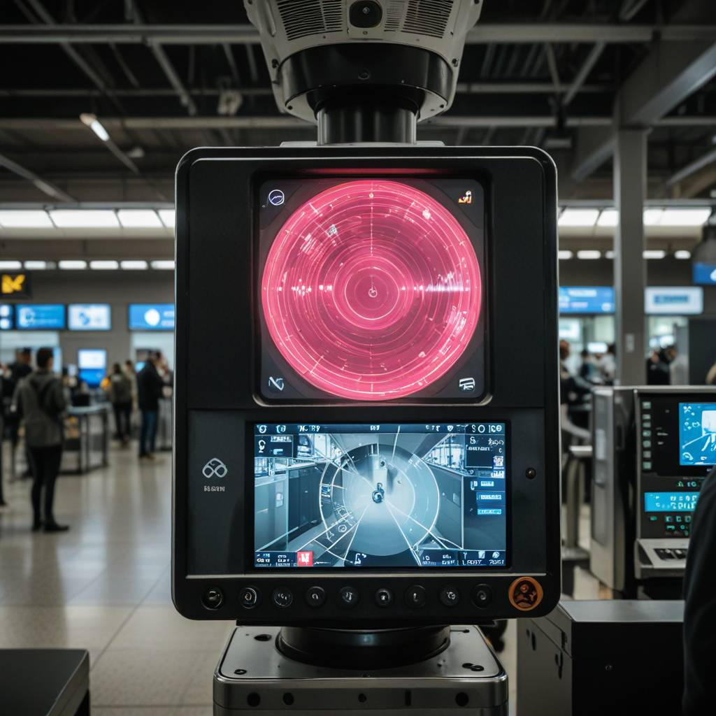



Real-Time Object Recognition Use Cases?
Airport Security Surveillance
Azure AI
Services
Microsoft
Fabric
Near-Real-Time Object Recognition using Azure AI and Microsoft Fabric | Sai Prudhvi Neelakantam
Power BI & Fabric Summit 2025

Slide 9
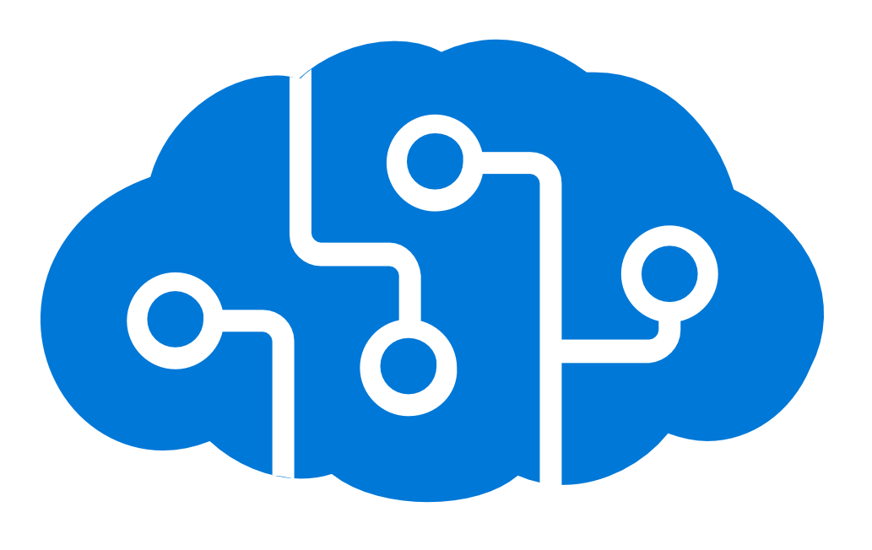
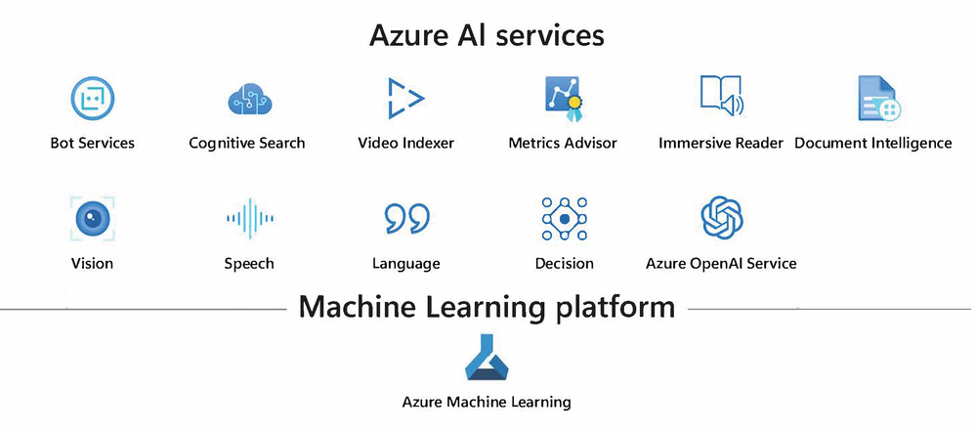
Azure AI Services
Azure AI Hub/ Studio/ Foundry
Near-Real-Time Object Recognition using Azure AI and Microsoft Fabric | Sai Prudhvi Neelakantam
Power BI & Fabric Summit 2025

Slide 10
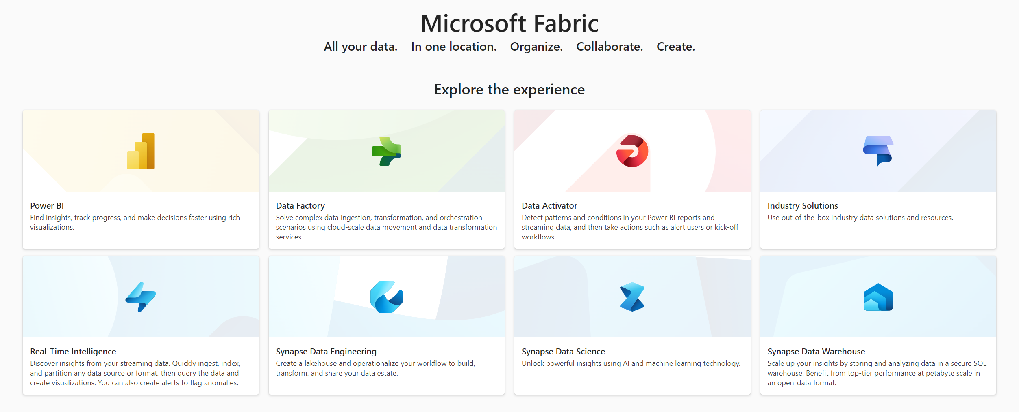
Microsoft Fabric
Near-Real-Time Object Recognition using Azure AI and Microsoft Fabric | Sai Prudhvi Neelakantam
Power BI & Fabric Summit 2025

Slide 11
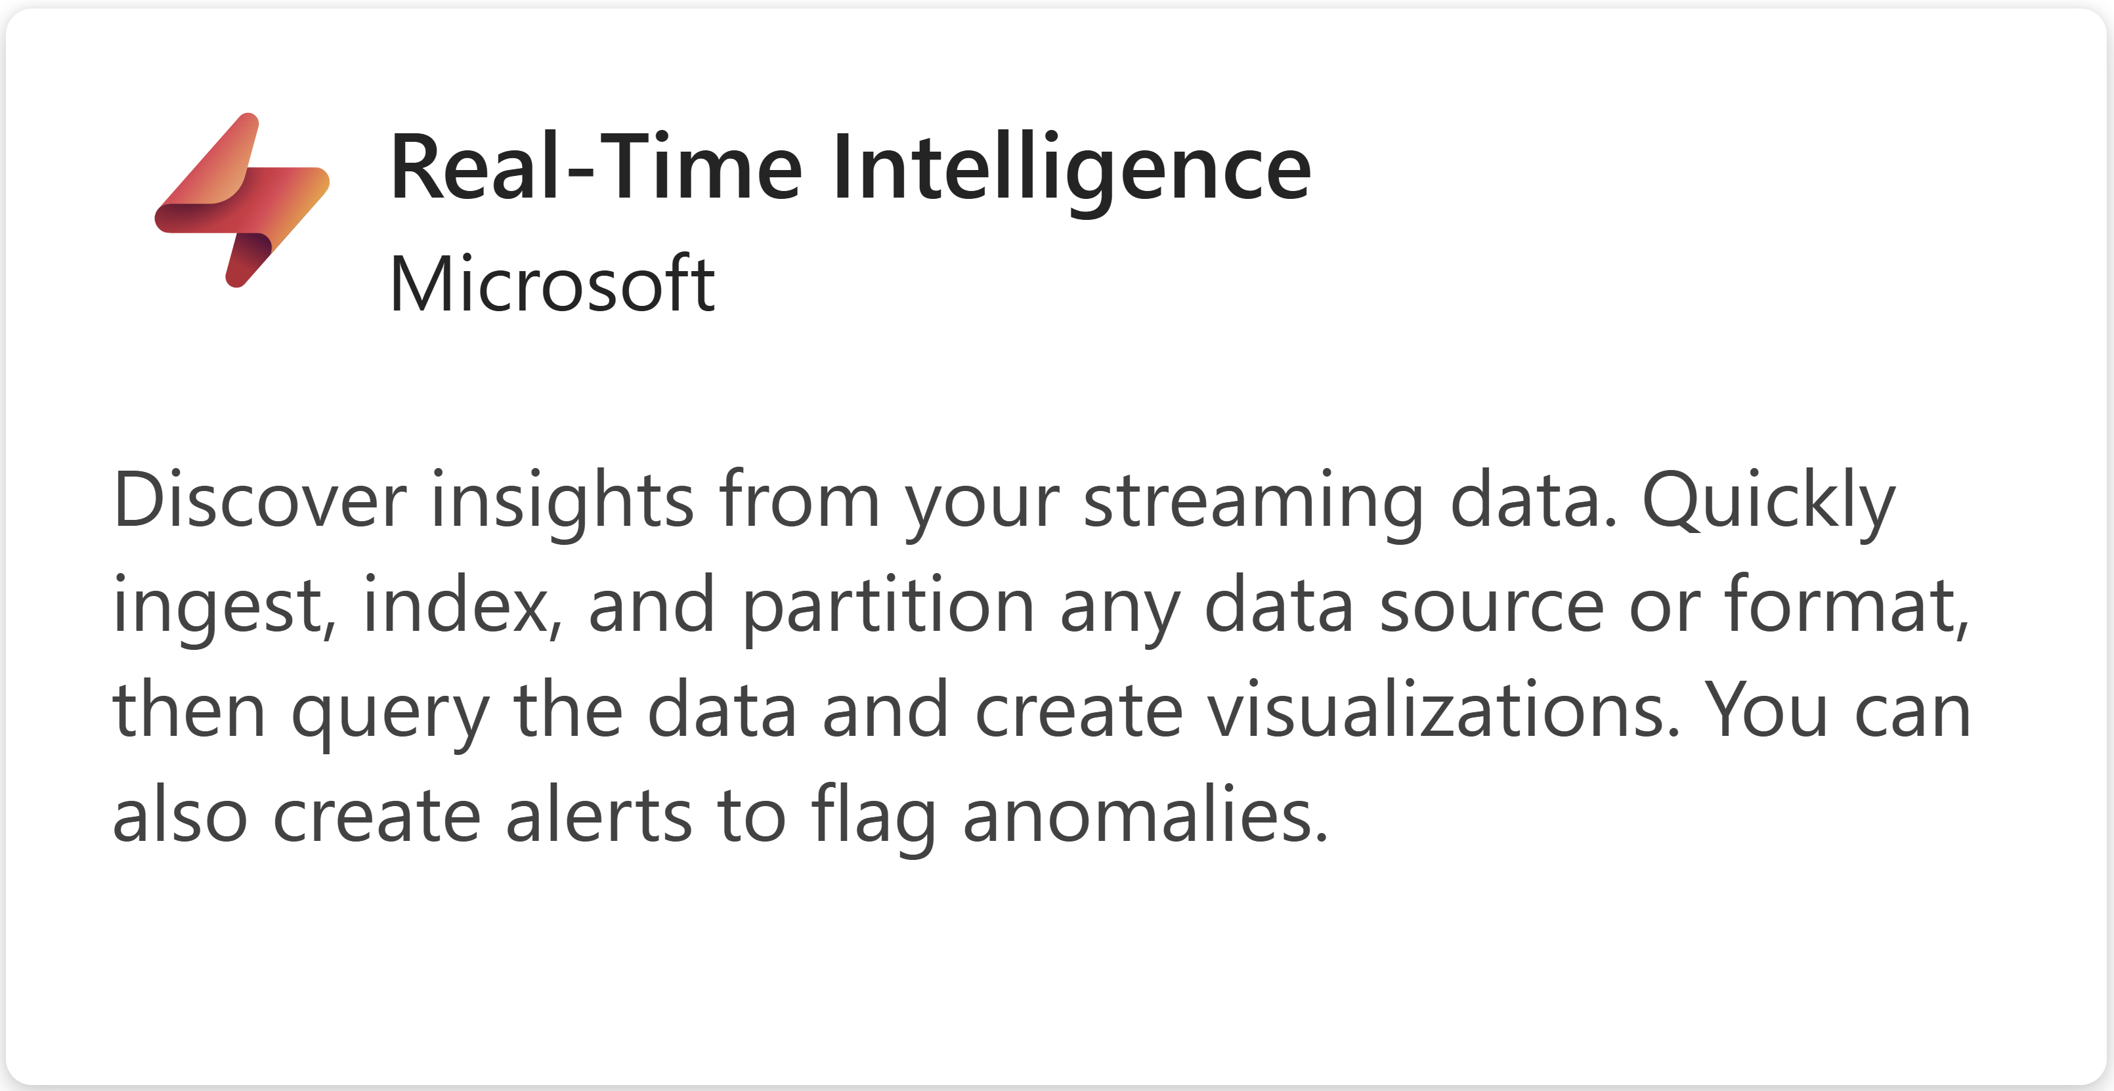
Microsoft Fabric
Near-Real-Time Object Recognition using Azure AI and Microsoft Fabric | Sai Prudhvi Neelakantam
Power BI & Fabric Summit 2025

Slide 12
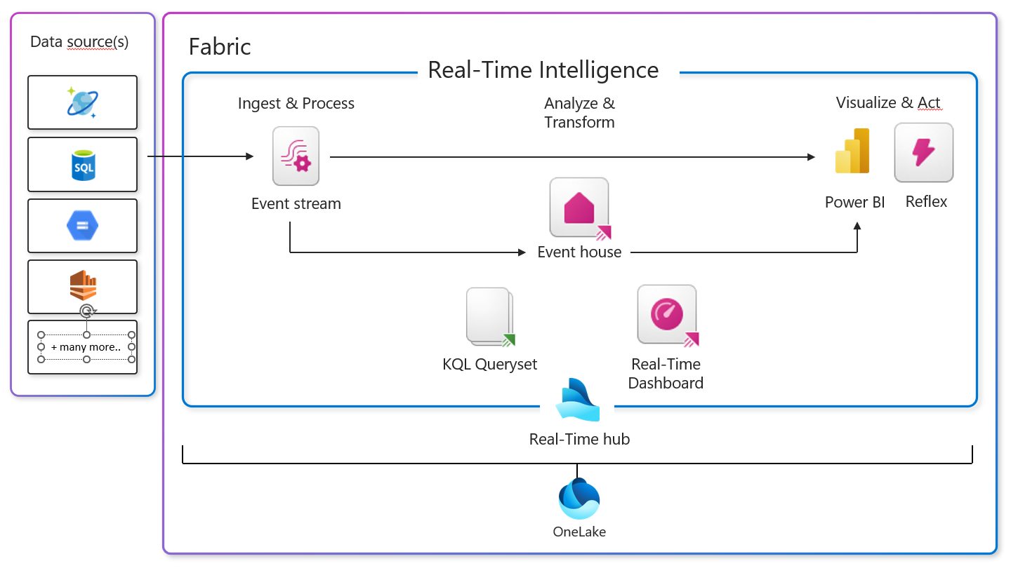
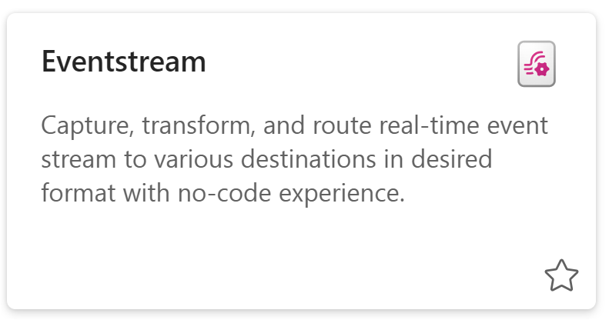
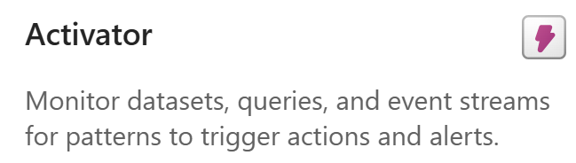
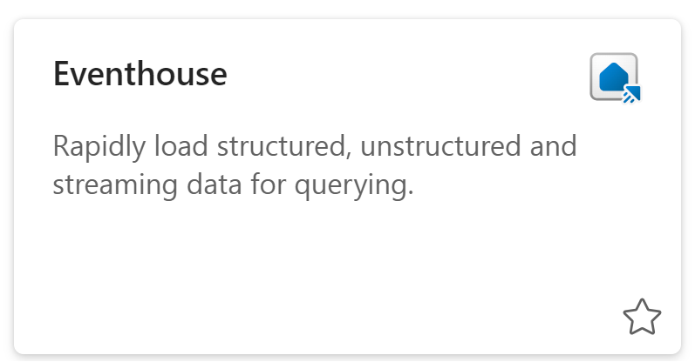
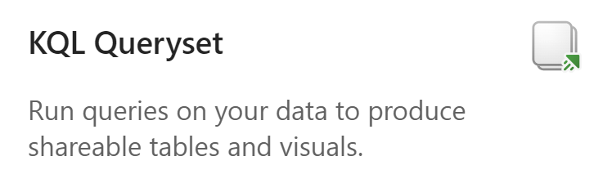
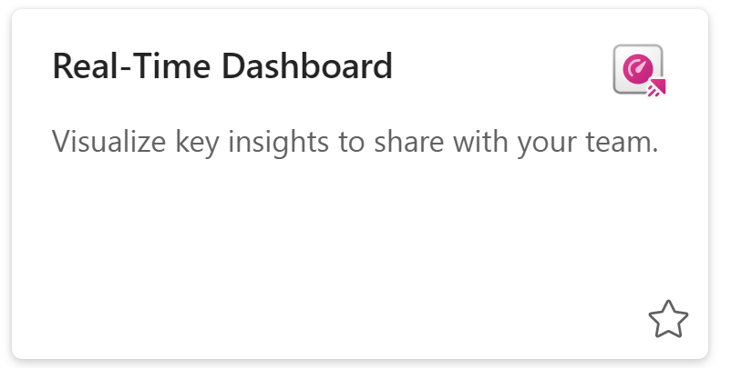

Items in Fabric Real-Time Intelligence
Activator
Near-Real-Time Object Recognition using Azure AI and Microsoft Fabric | Sai Prudhvi Neelakantam
Power BI & Fabric Summit 2025

Slide 13
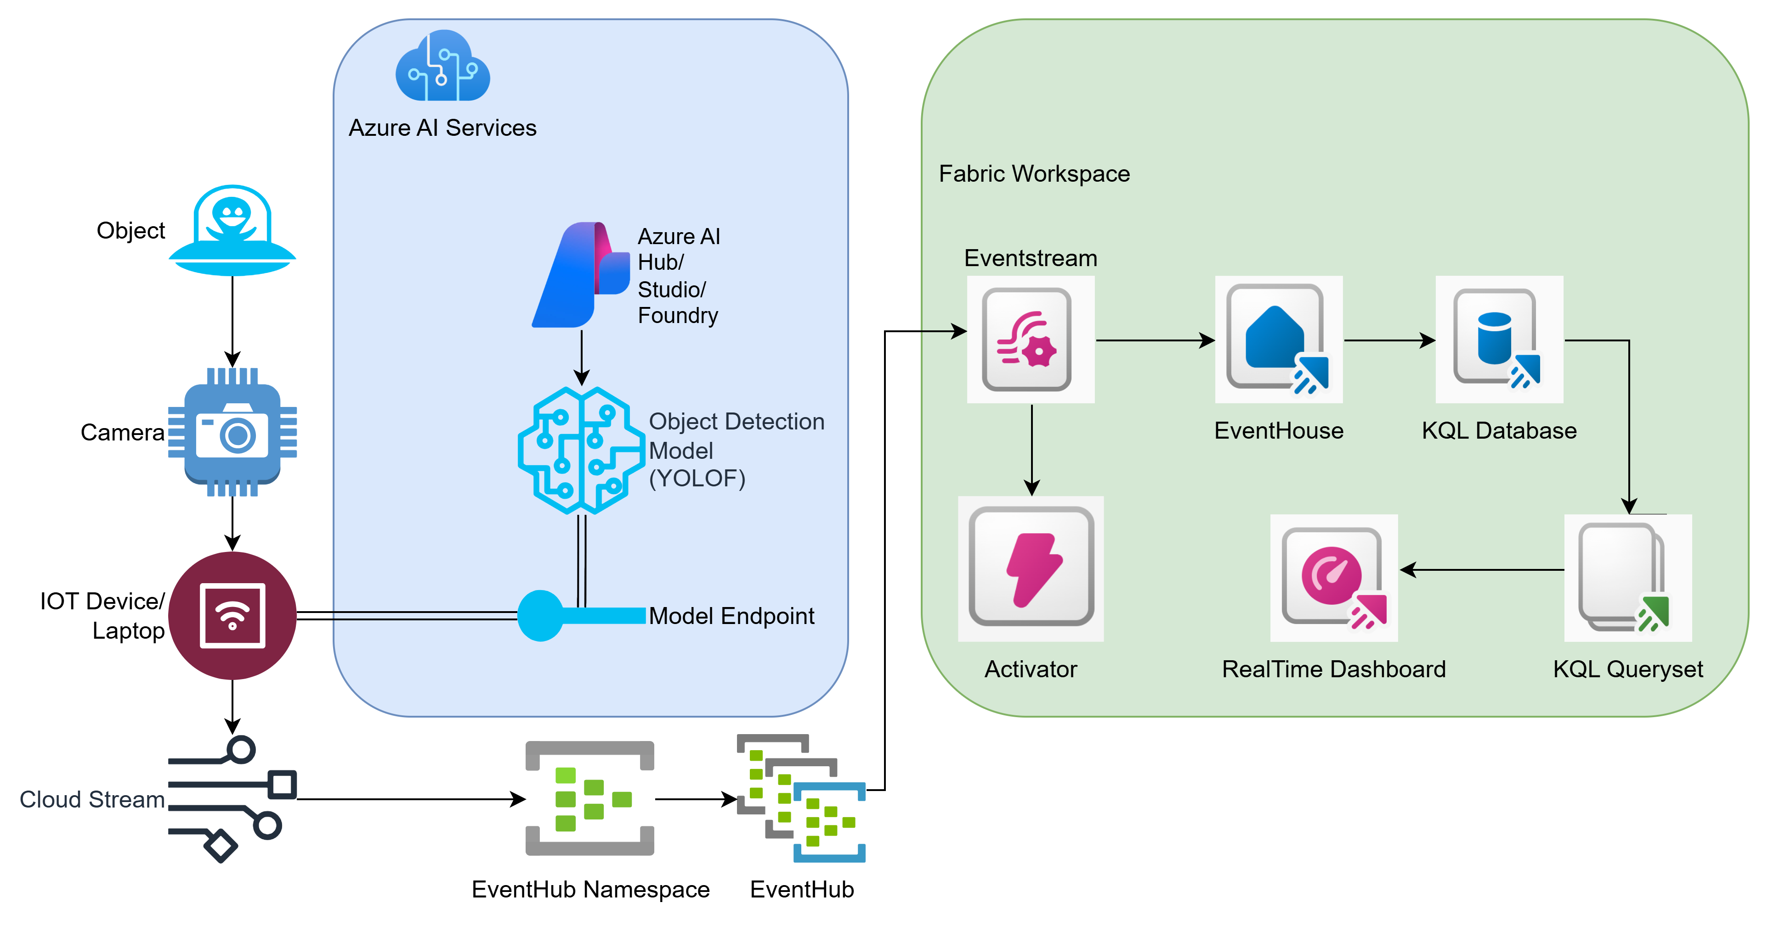

Architecture
YOLOF
Why Choose YOLOF?
Trained on COCO dataset with 1.5 million object instances primarily for object segmentation.
Simplicity - Uses a single layer for detection, making it easier and faster.
Performance - Delivers high accuracy and speed – 2.5x faster times than RetinaNet.
Near-Real-Time Object Recognition using Azure AI and Microsoft Fabric | Sai Prudhvi Neelakantam
Power BI & Fabric Summit 2025

Slide 14
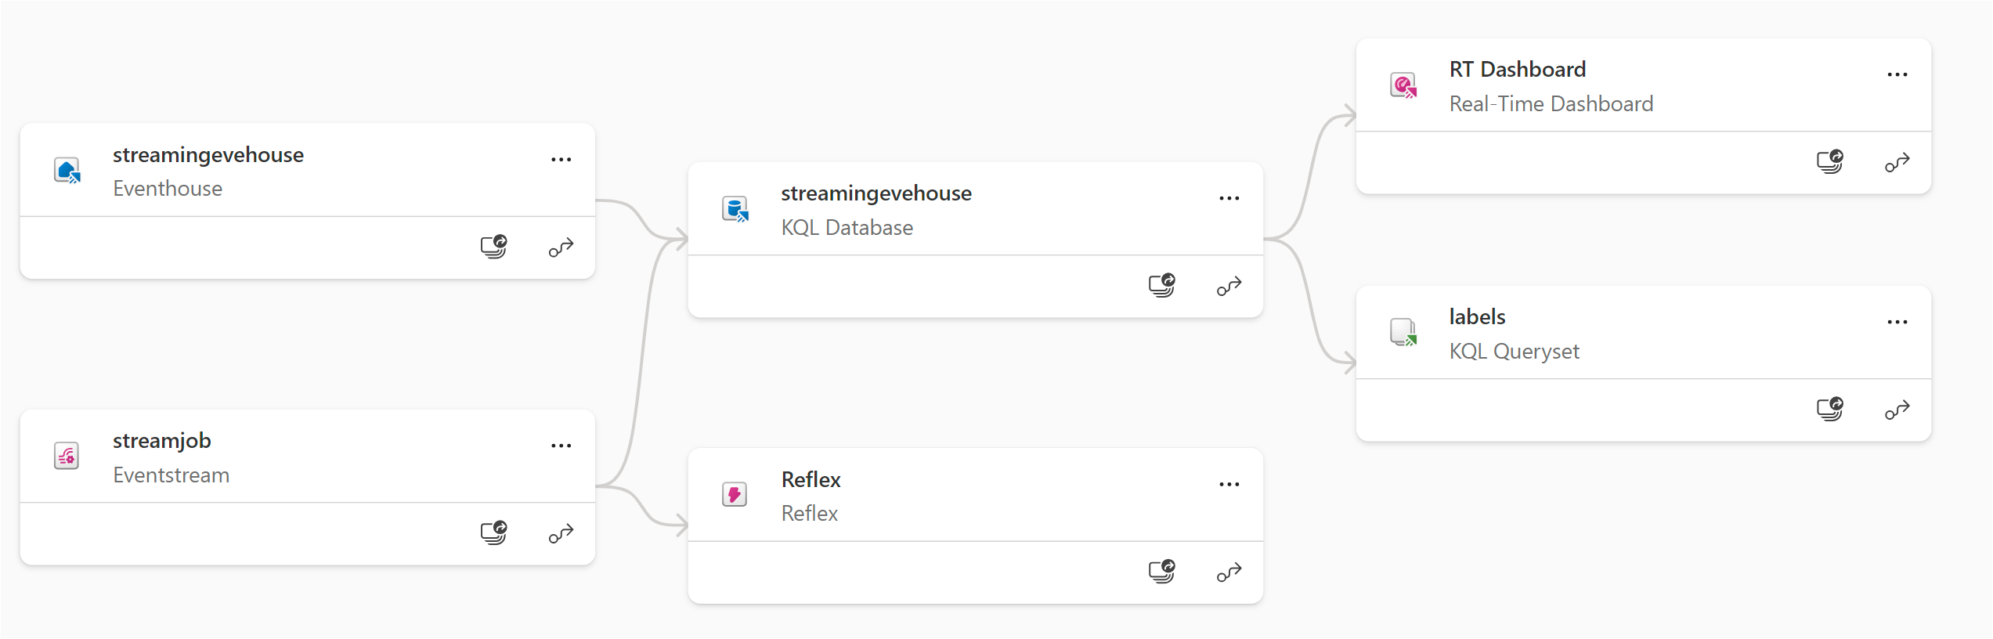
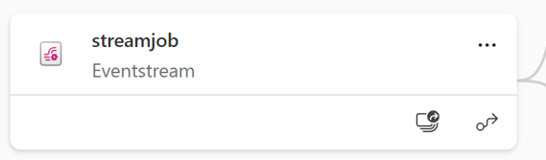
Fabric Realtime Intelligence Lineage
Near-Real-Time Object Recognition using Azure AI and Microsoft Fabric | Sai Prudhvi Neelakantam
Power BI & Fabric Summit 2025

Slide 15
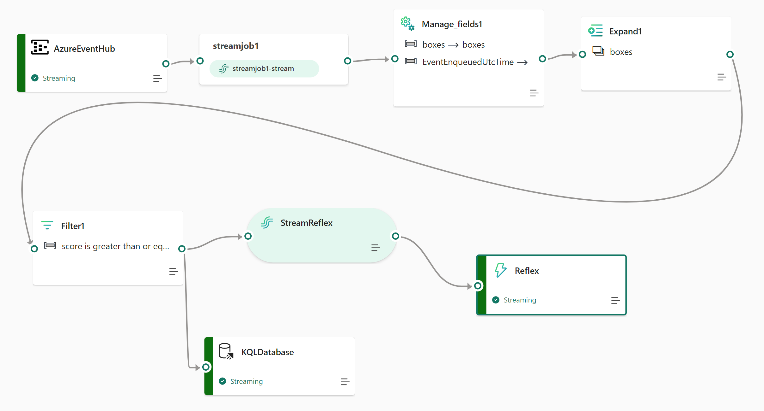
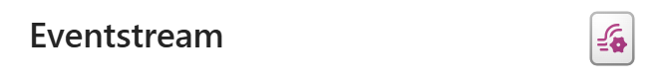
Fabric Eventstream
Near-Real-Time Object Recognition using Azure AI and Microsoft Fabric | Sai Prudhvi Neelakantam
Power BI & Fabric Summit 2025

Slide 16
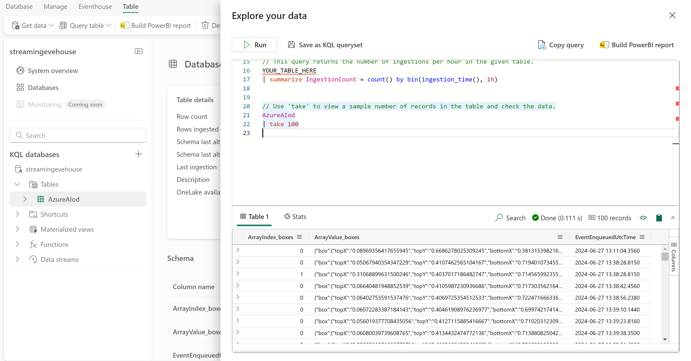

KQL Database in Eventhouse
Near-Real-Time Object Recognition using Azure AI and Microsoft Fabric | Sai Prudhvi Neelakantam
Power BI & Fabric Summit 2025

Slide 17
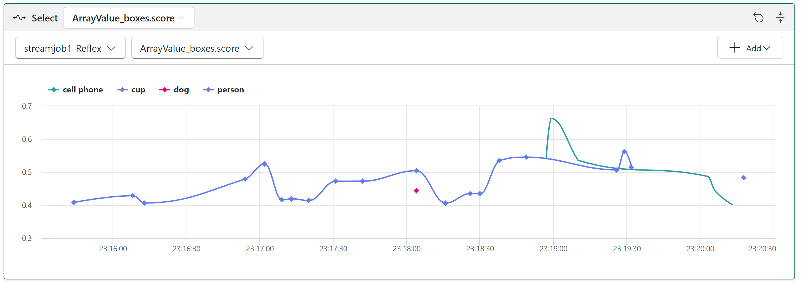

Fabric Reflex
Near-Real-Time Object Recognition using Azure AI and Microsoft Fabric | Sai Prudhvi Neelakantam
Power BI & Fabric Summit 2025

Slide 18
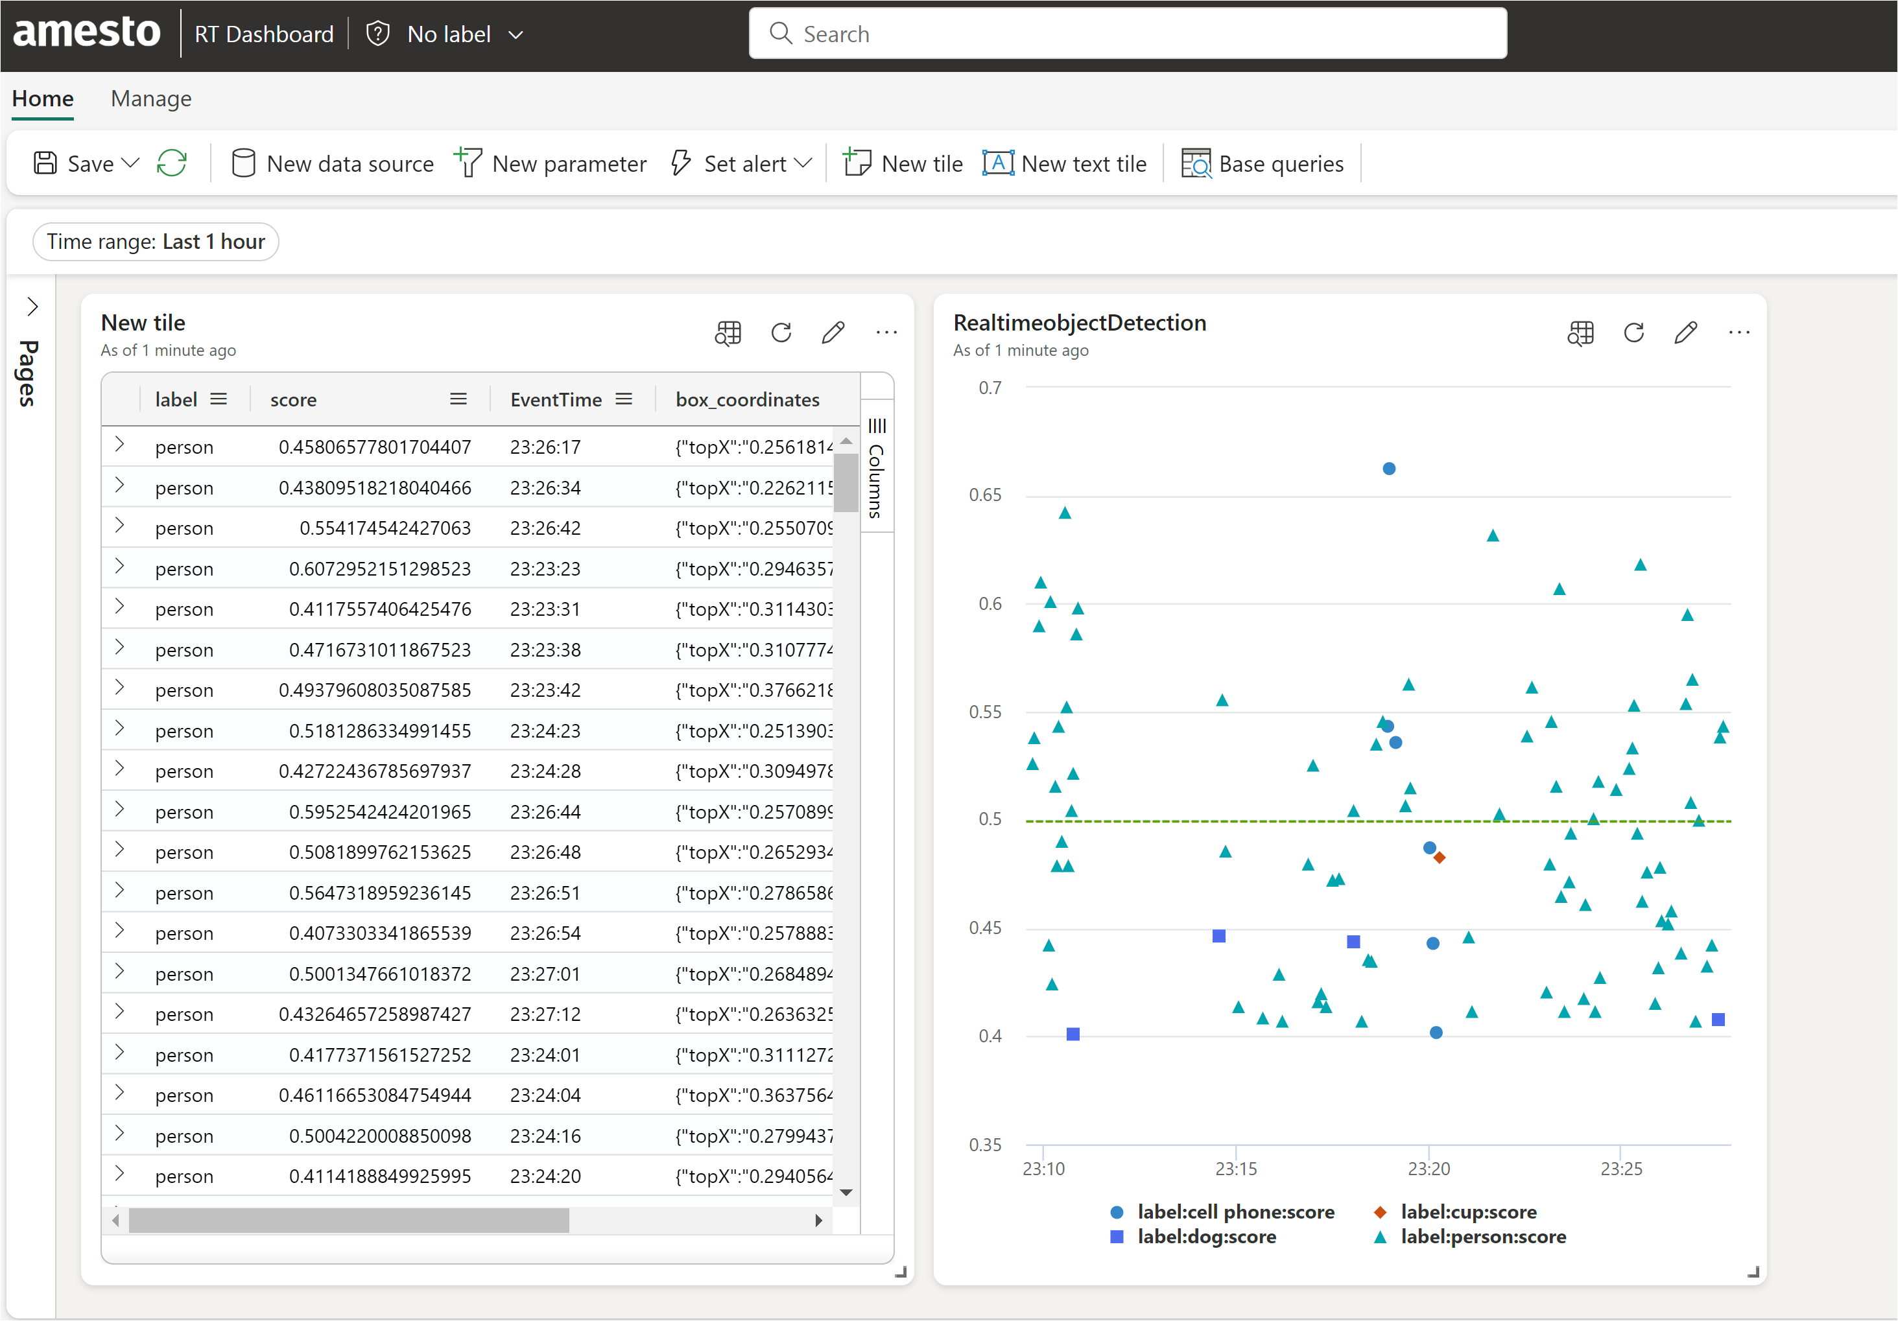

Fabric Realtime Dashboard
Near-Real-Time Object Recognition using Azure AI and Microsoft Fabric | Sai Prudhvi Neelakantam
Power BI & Fabric Summit 2025

Slide 19
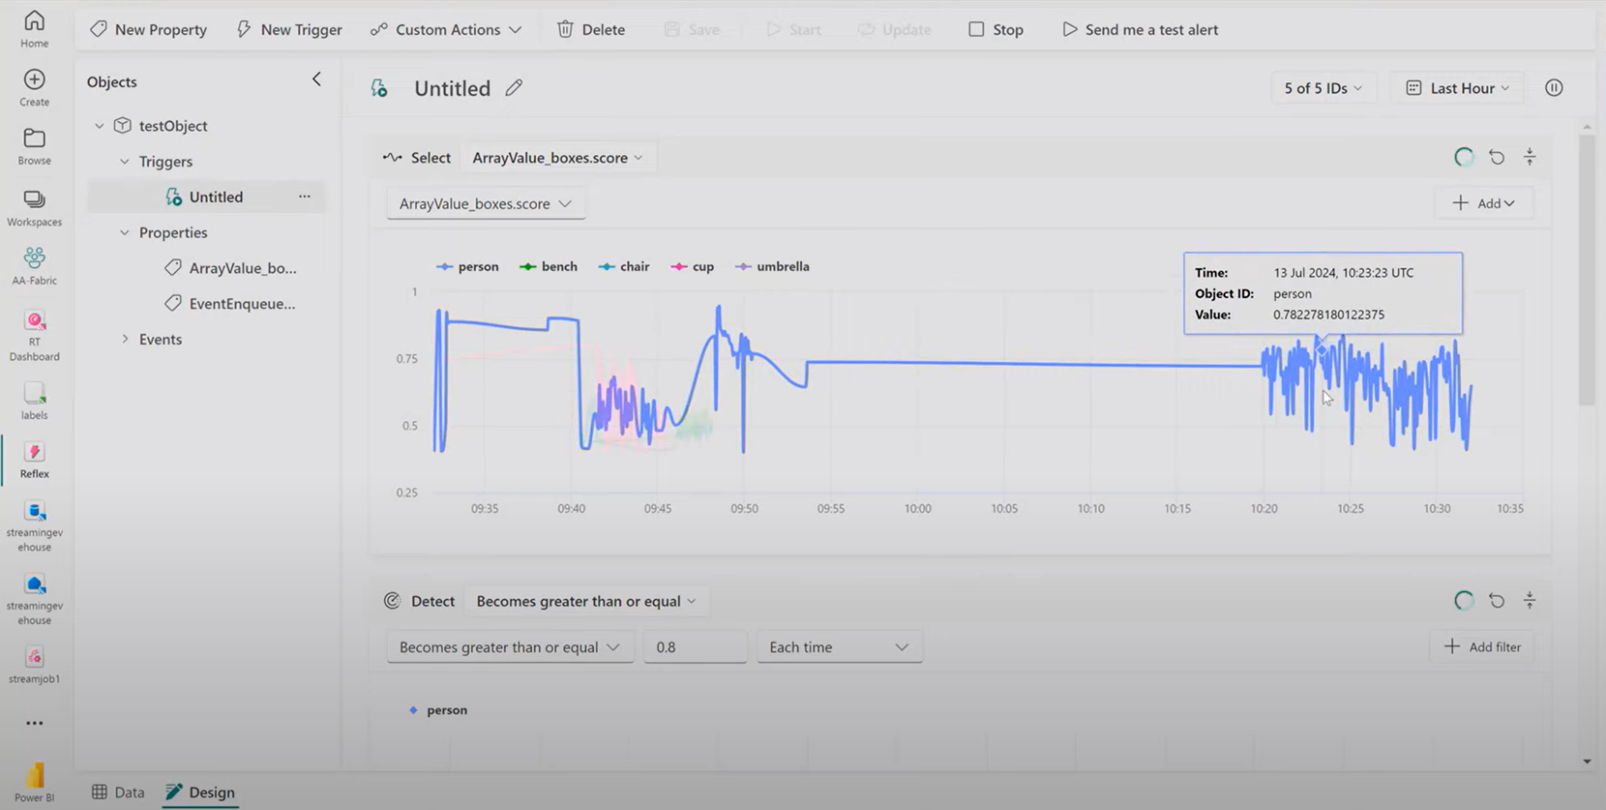


Slide 20
Recap
Near-Real-Time Object Recognition using Azure AI and Microsoft Fabric
Near-Real-Time Object Recognition using Azure AI and Microsoft Fabric | Sai Prudhvi Neelakantam
Power BI & Fabric Summit 2025

Slide 21

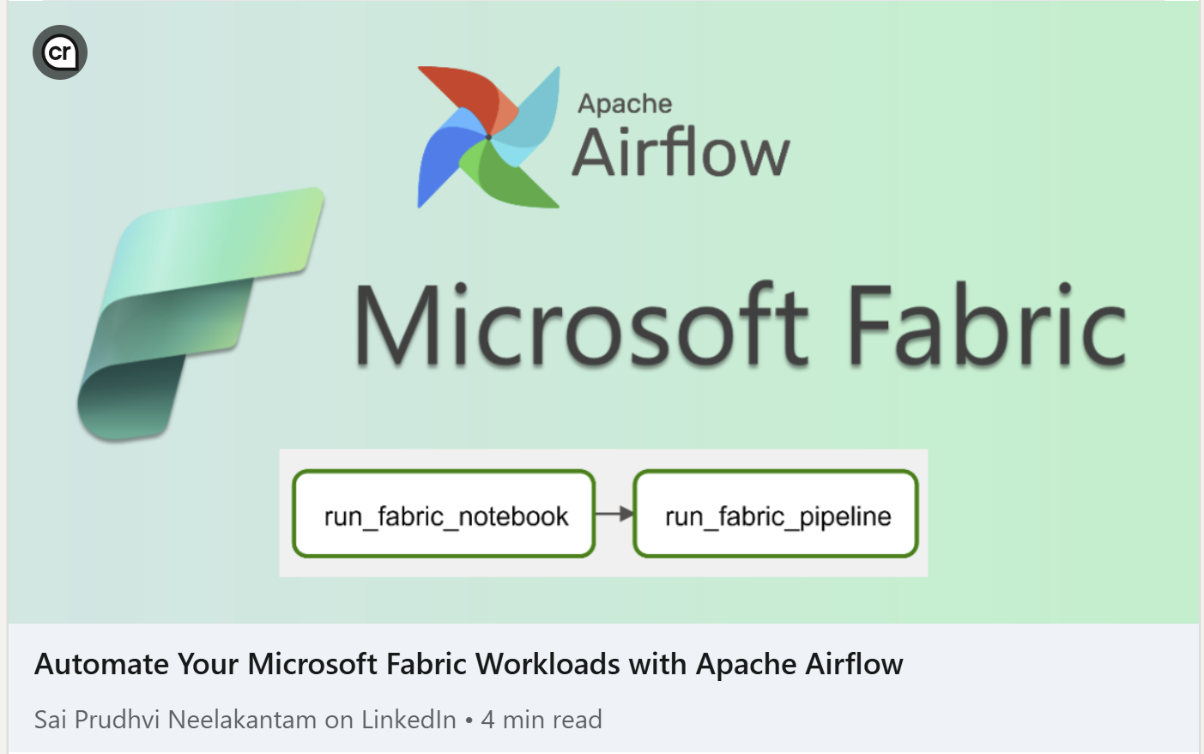
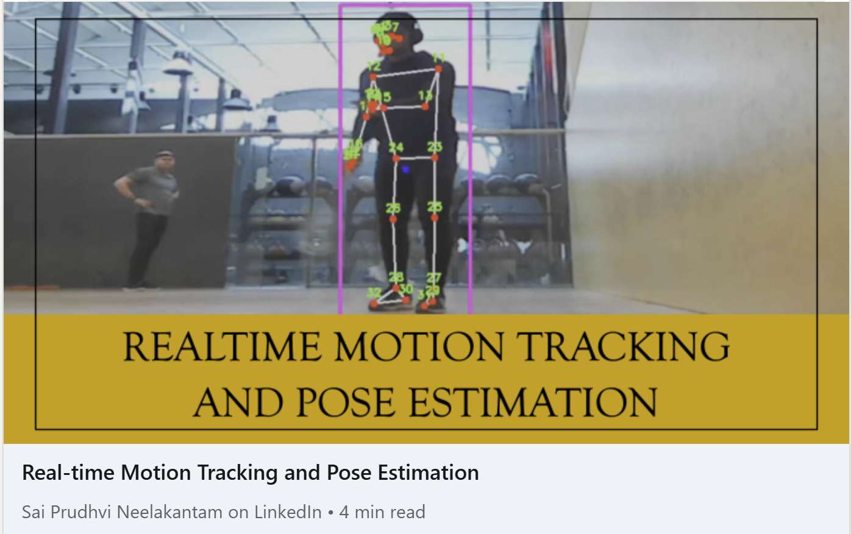
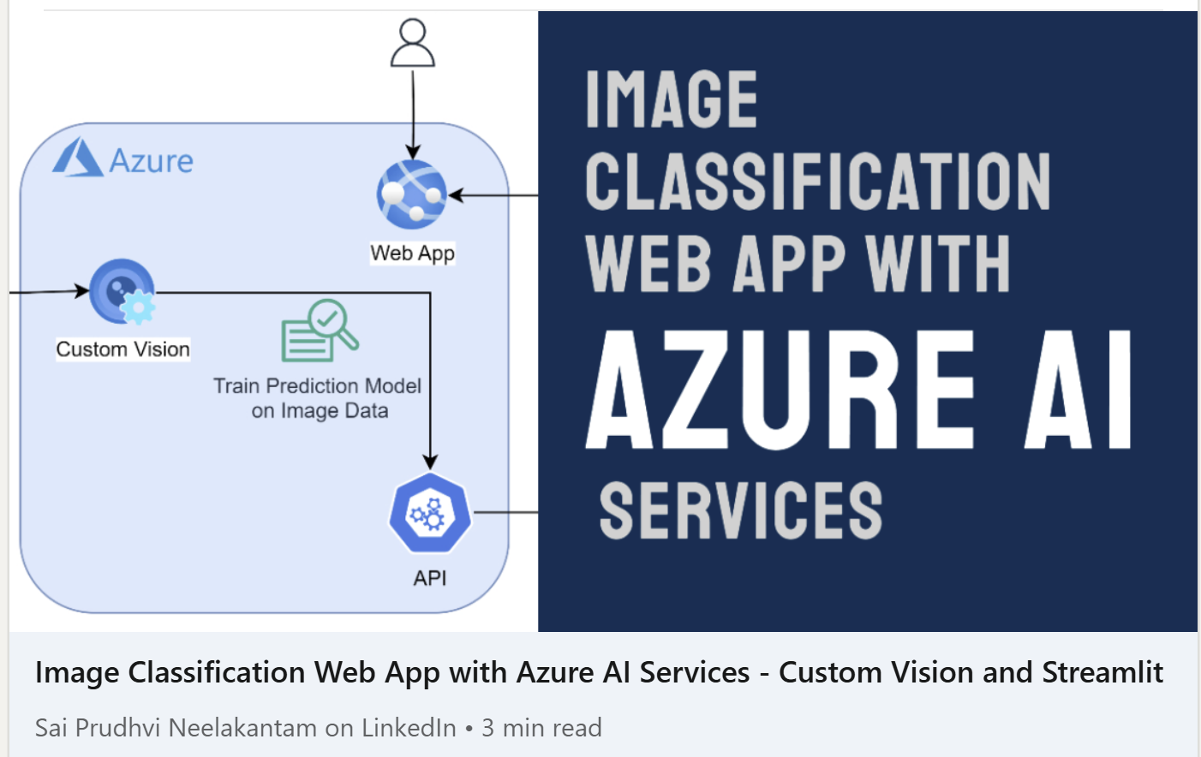

Slide 22

THANK YOU!
Power BI & Fabric Summit 2025
Sai Prudhvi Neelakantam
geekindata.com
sai@geekindata.com

Slide 23
AI/ML Model YOLOF (You Only Look One-level Feature)
Training and
Evaluation
Dataset: Trained on the widely-used COCO dataset.
Accuracy: Achieves a respectable box AP of 37.5.
User-Friendly
Easy to Use: Provides scripts for real-time and batch inference, and for finetuning on your own dataset.
Visual Results
Clear Outputs: Detects objects in images with clear bounding boxes, labels, and confidence scores.
Why Choose YOLOF?
Simplicity: Uses a single layer for detection, making it easier and faster.
Performance: Delivers high accuracy and speed.
Efficiency: Faster than many other models, like RetinaNet and YOLOv4, and requires less training time.
Near-Real-Time Object Recognition using Azure AI and Microsoft Fabric | Sai Prudhvi Neelakantam
Power BI & Fabric Summit 2025

